Slide 1
War and Genocide in Cuba
John Lawrence Tone
Ivan Allen College of Liberal Arts
Georgia Institute of Technology

Slide 2
How Cuba Achieved Independence
Máximo Gómez Declares Total War
Most Cubans Enjoy Differential Immunity
American Intervention

Slide 3
Máximo Gómez

Slide 4
José Martí

Slide 5
"What are we, General? The heroic and modest servants of an idea that fires our hearts . . . or valiant military chieftains who with whip in hand and spurs on our boots prepare to take war to our people in order later to become their lords?"
--José Martí

Slide 6
Antonio Maceo

Slide 7
In Cuba “stone will not remain upon stone”
Cuba will be “drowned in blood and devoured by flames”
We have “only one duty: to triumph”
In a war of “extermination” “all means” are acceptable
--Máximo Gómez

Slide 8
Bernabé Boza

Slide 9
Valeriano Weyler

Slide 10
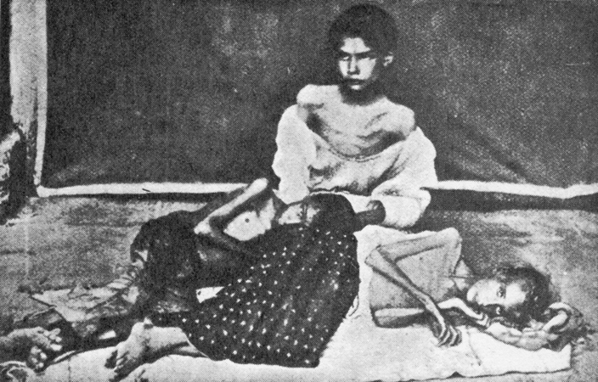
Reconcentrados

Slide 11
Calixto García

Slide 12
Carlos Finlay

Slide 13
Aedes aegypti

Slide 14
Spanish Deaths, 1895-1898
Deaths in Combat: 4,032*
Deaths from Disease: 41,288
*Includes losses in combat with U.S. forces

Slide 15
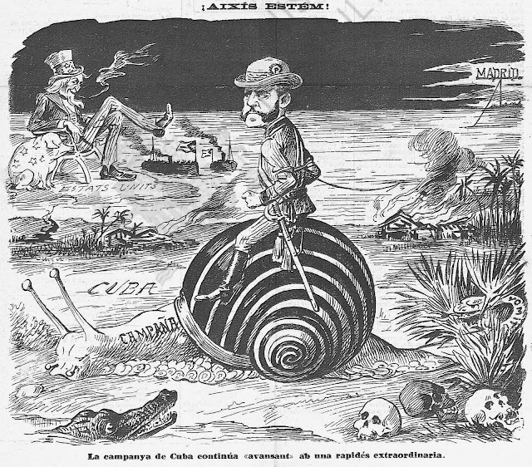
Spanish Anti-War Sentiment Grows

Slide 16
Causes of U.S. Intervention
Humanitarian Crisis
Economic and Financial Interests
History of American Involvement
Cuban Propaganda
Growth of American Power
Destruction of the Maine

Slide 17
The Battleship Maine

Slide 18
Antonio Cánovas

Slide 19
The Corpus Christi Bombing of 1896

Slide 20
Montjuich

Slide 21
Ramón Betances

Slide 22
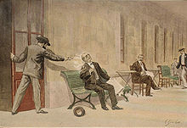
Michele Angiolillo

Slide 23
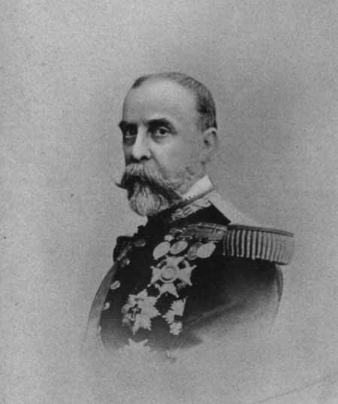
Praxedes Sagasta Ramón Blanco

Slide 24
Fitzhugh Lee

