Slide 1
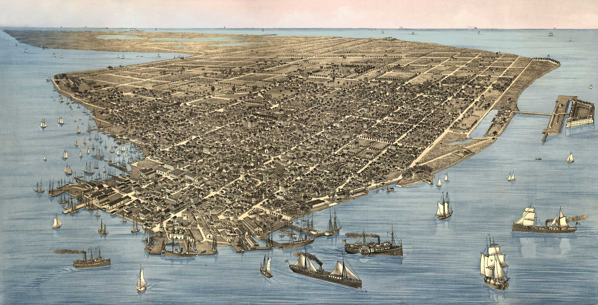
Revolutionary Key West: 1868-1898 Gerald E. Poyo, St. Mary’s University

Slide 2
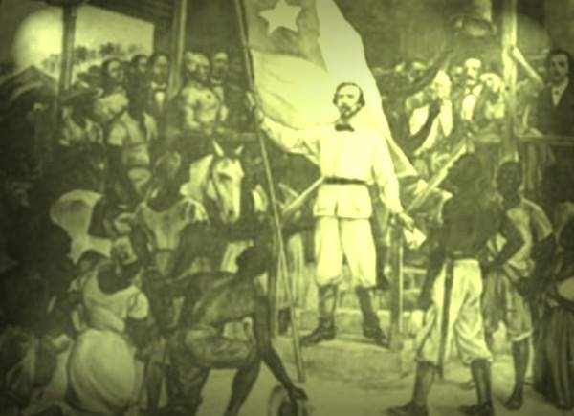
El Grito de Yara October 10, 1868
Carlos Manuel de Céspedes declaring Cuban Independence from Spain

Slide 3
Key West’s Radical Ideal
Identity = Recognizing Cubans as a distinct people with unique culture separate from Spain.
Popular Nationalism = Absolute Independence with racial and social equality for all.
Revolutionary = Immediate armed action regardless of the cost.

Slide 4
Contents
Cigars: Fueling a Revolutionary Nationalist Community
Forging an Enduring Revolutionary Nationalist Community
Evolving Revolutionary Strategies (1880s)
Preserving the Revolutionary Community: Labor and Nationalism
José Martí and Key West: Rethinking the Relationship
Cuban Nationalism and US Imperialism

Slide 5
1 Cigars: Fueling A Revolutionary Nationalist Community in Key West
War in Cuba and the cigar industry’s economic engine produced in Key West a Cuban multi-cultural working class community with diverse social and political interests.
Cuban activists formed this community into a powerful nationalist and revolutionary movement dedicated to dislodging Spanish power in Cuba.

Slide 6
Key West Cigar Industry
The Cigar Industry made possible an effective and enduring nationalist movement.
Key West population grew from around 6,000 in 1970 to about 20,000 in 1990. Generally averaging about one-third Cuban.
Key West cigar entrepreneurs generally had little experience with tobacco industry on arriving in the United States, with notable exception of Vicente Martínez Ybor ( who moved to Tampa in 1886)

Slide 7
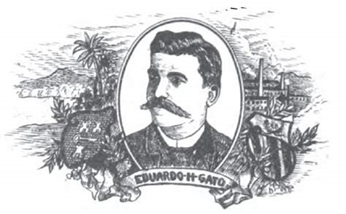
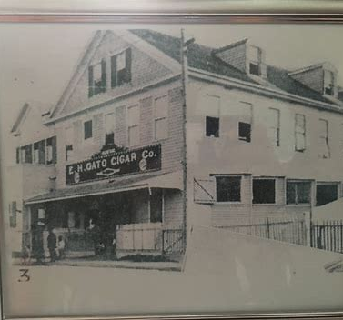
Eduardo Hidalgo Gato
The iconic Cuban cigar entrepreneur in Key West was Eduardo Hidalgo Gato. Arrived in New York 1869; moved to Key West 1876; employed 500 workers in 1887.

Slide 8
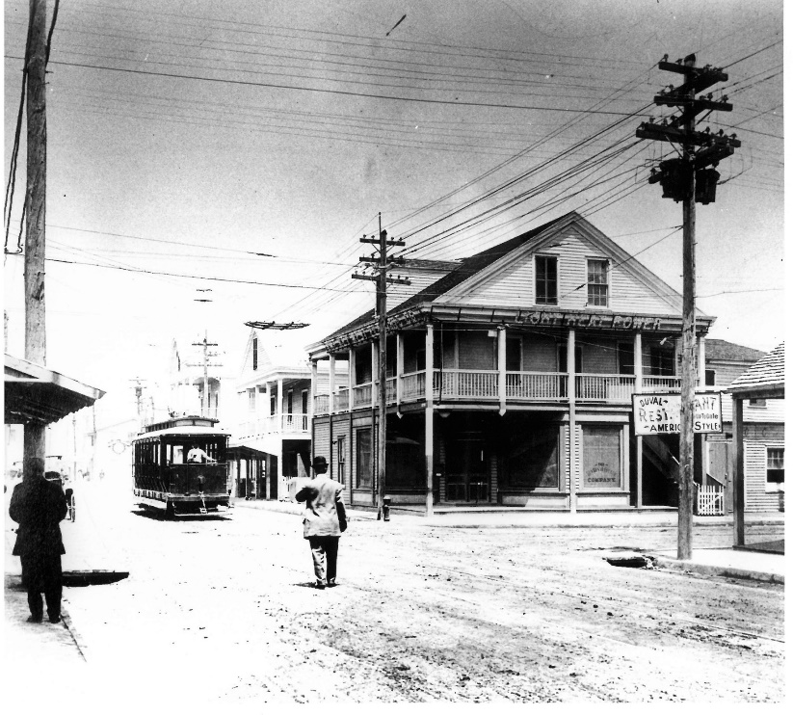
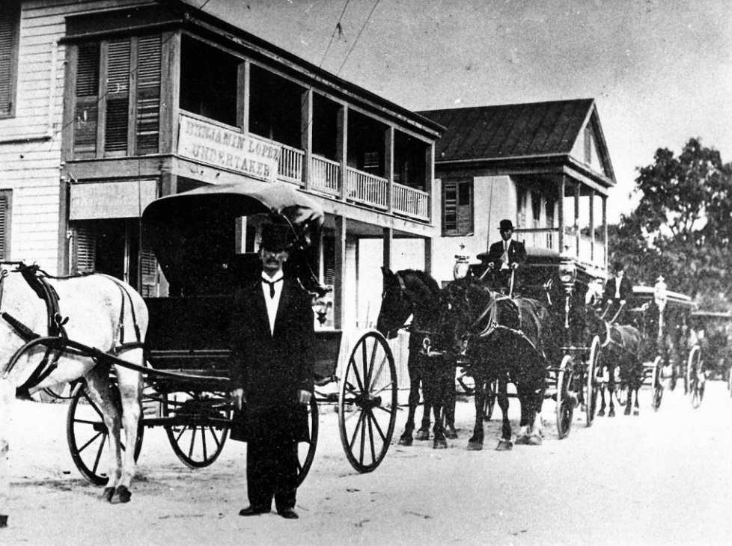
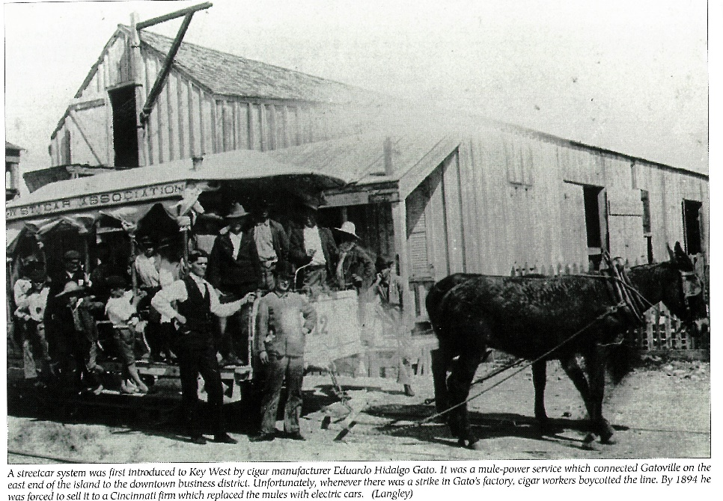
A Cuban Community in Key West (Cayo Hueso)
Cigar industry gave rise to all manner of economic activity critical to any dynamic fully-formed community, from bakeries to funeral homes.

Slide 9
Questions

Slide 10
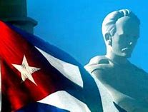
2 Forging an Enduring Revolutionary Nationalist Community
Identity, Nationalism & Mobilization

Slide 11
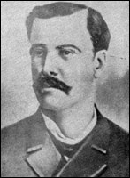
Combating Political Reform and Annexation in Cuba
Reform and Annexation to the United States had deep roots in Cuban political thinking and history.
Antonio Zambrana- Autonomist
Juan Bellido de Luna- Annexationist

Slide 12
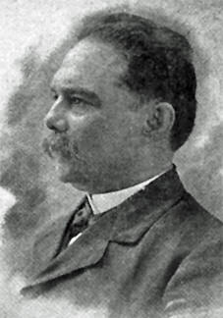
Key West Revolutionary Nationalist Leadership Supported independence at all costs: José Francisco Lamadriz- Arrived in Key West from NY after Ten Years War. José Dolores Poyo- Organized in Key West during Ten Years War. Fernando Figueredo- Arrived in Key West in 1880 after fighting in the Ten Years War.
Fernando Figueredo
José Dolores Poyo

Slide 13
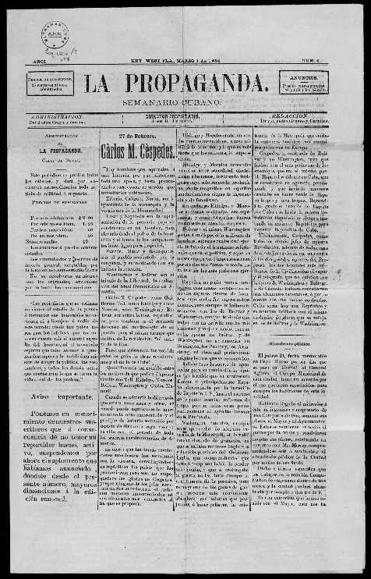
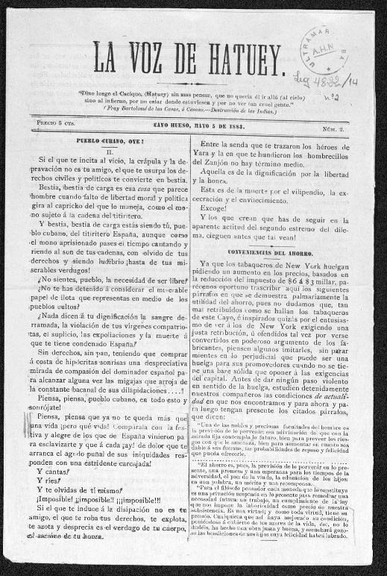
Revolutionary Press
Propaganda and Indoctrination
José Rafael Estrada, editor
Fernando Figueredo, editor
José María Reyes & José Dolores Poyo, editors
José Dolores Poyo, editor

Slide 14
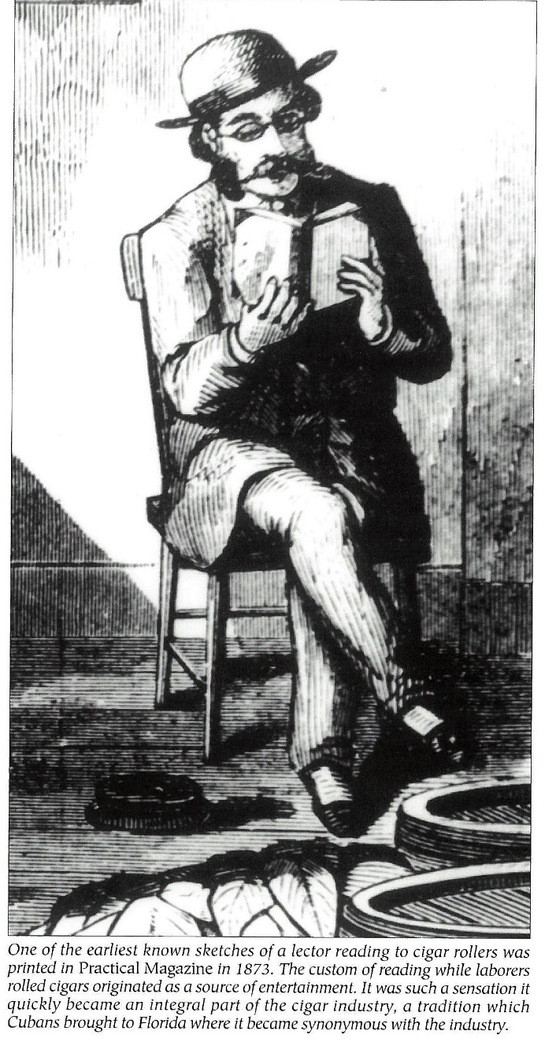
Cigar Factory Readers
Creating Political Awareness
José Maria Reyes, Wolff Factory
José Dolores Poyo, Ybor Factory
José María González, Gato Factory

Slide 15
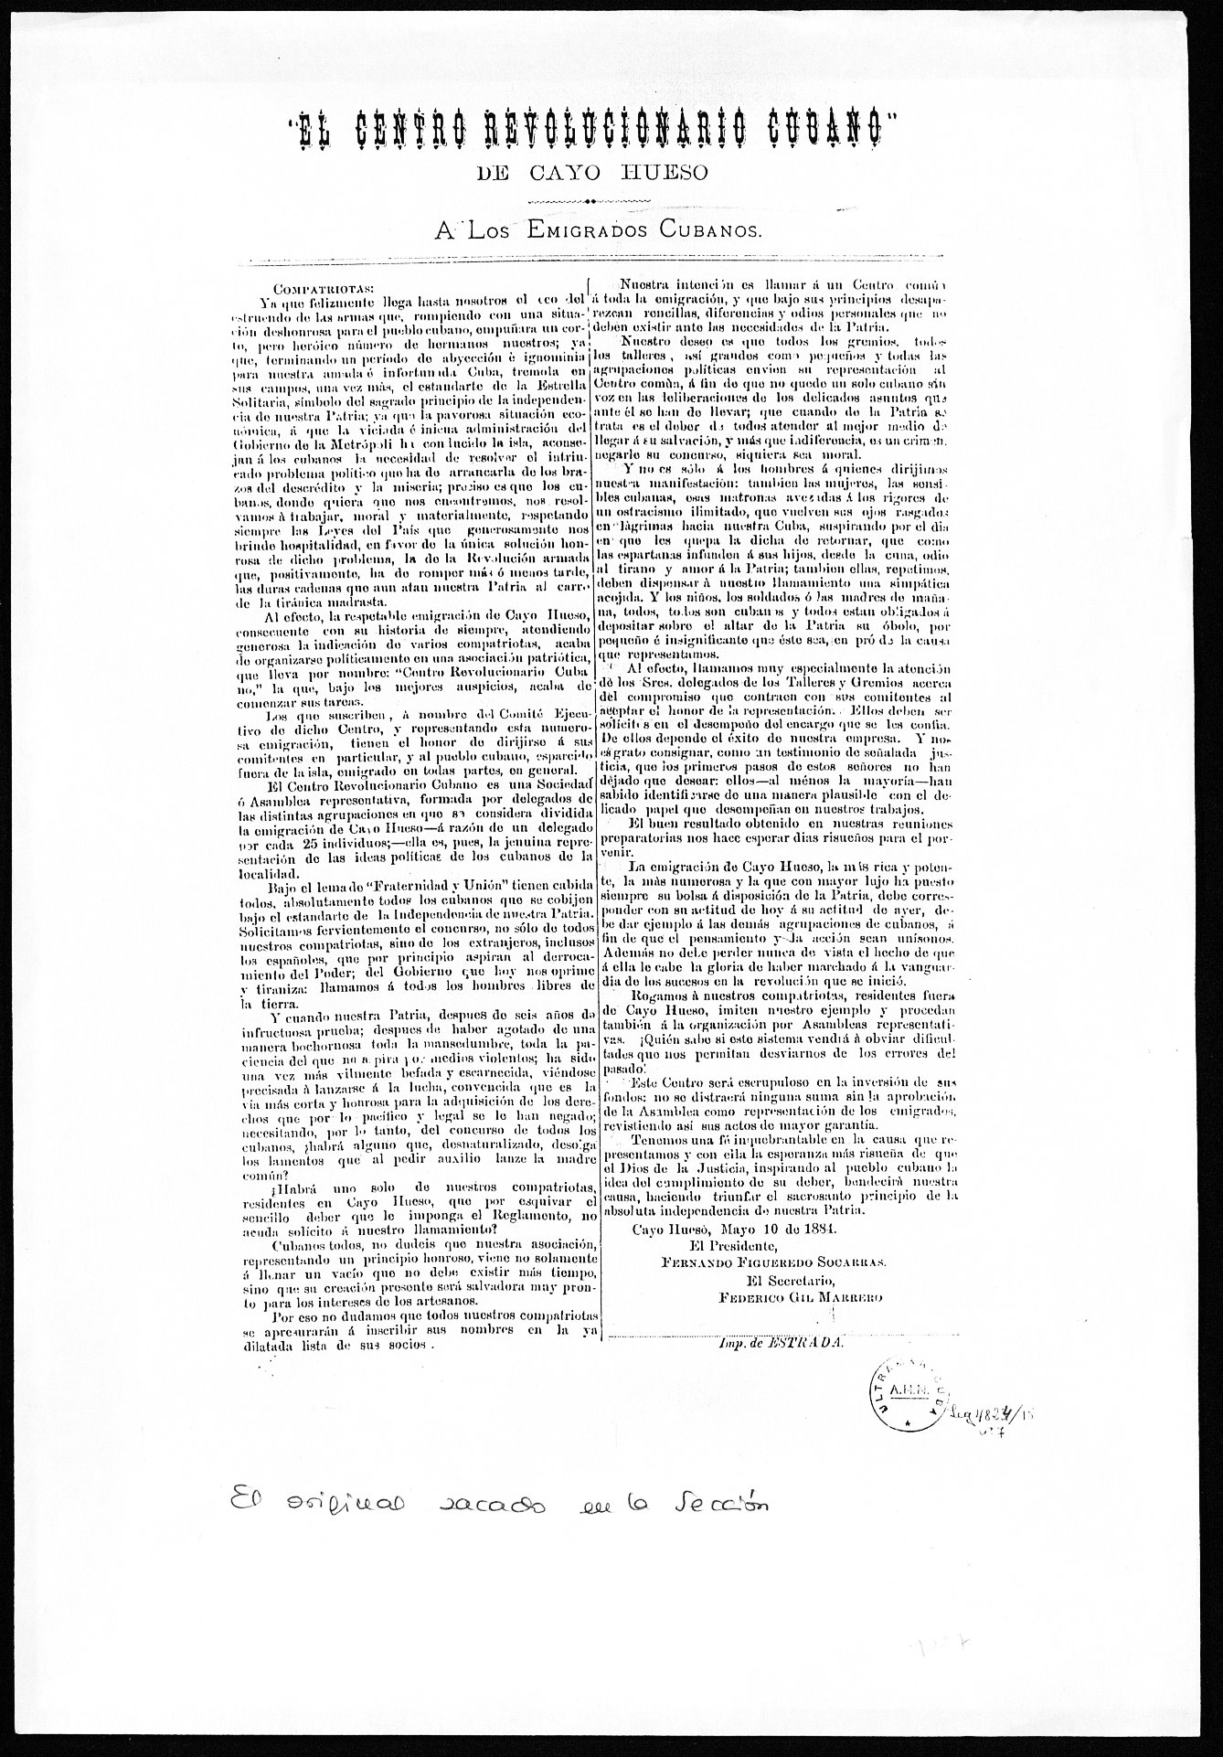
Political Clubs
Political clubs spearheaded organizing and fund raising efforts, and encouraged the formation of as many other clubs as possible. The goal was to organize the entire Cuban community into political clubs.
Asociación Patriótica de Cayo Hueso—1869
Associación Patriótica del Sur--1871
Orden Cosmopolita del Sol—1878
Centro Revolucionario Cubano--1884

Slide 16
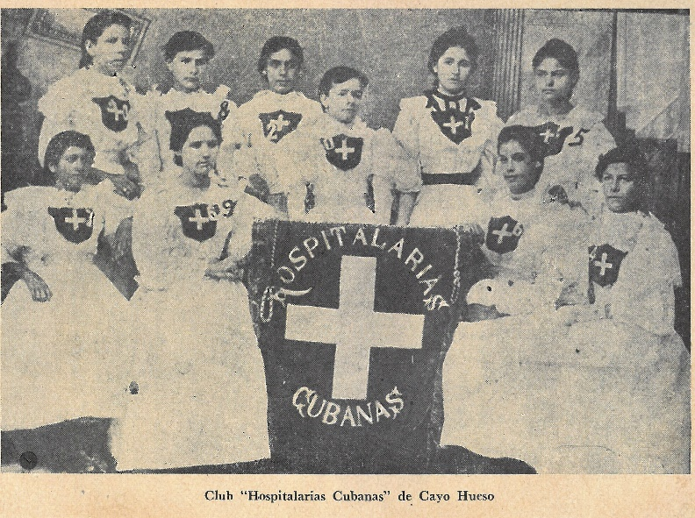
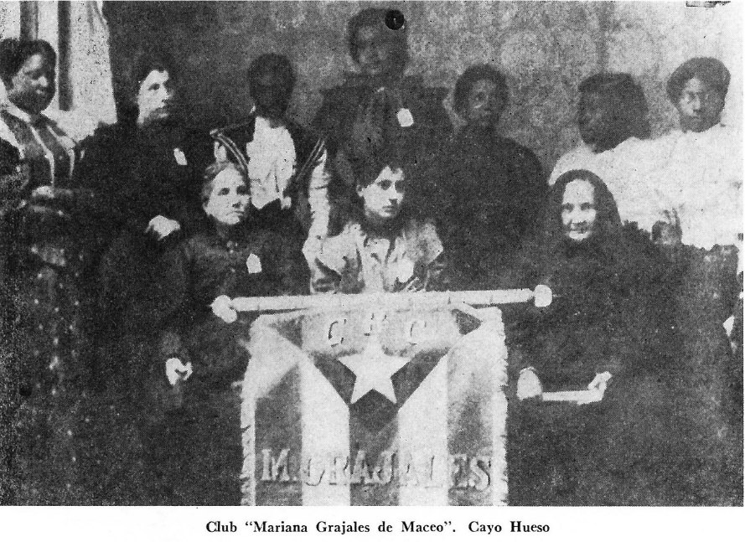
Women: grass-roots organizers
At the heart of grass-roots organizing, women prepared patriotic events, including bazzars, picnics, and public celebrations of different kinds.
Carolina Rodríguez, La Patriota

Slide 17
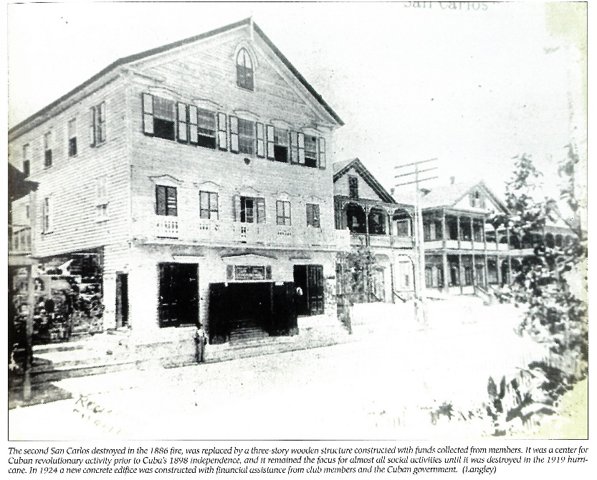
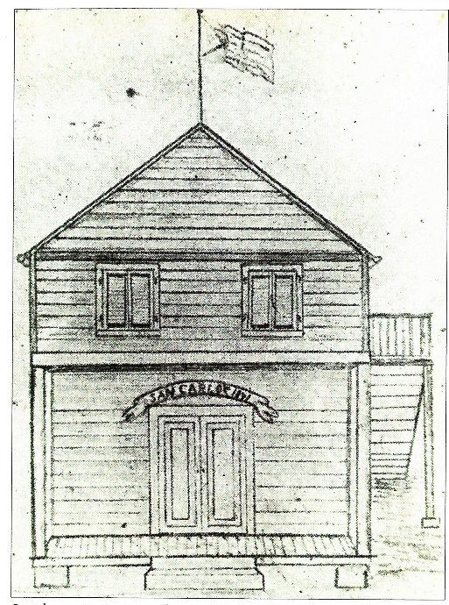
Schools: Education & Identity
San Carlos Institute
Children received education in Spanish and learned Cuban history, culture and geography—they remained Cuban and identified with the struggle for Cuban independence
San Carlos Institute- New building Inaugurated in 1887 after a fire in Key West.
San Carlos Institute- founded 1871

Slide 18
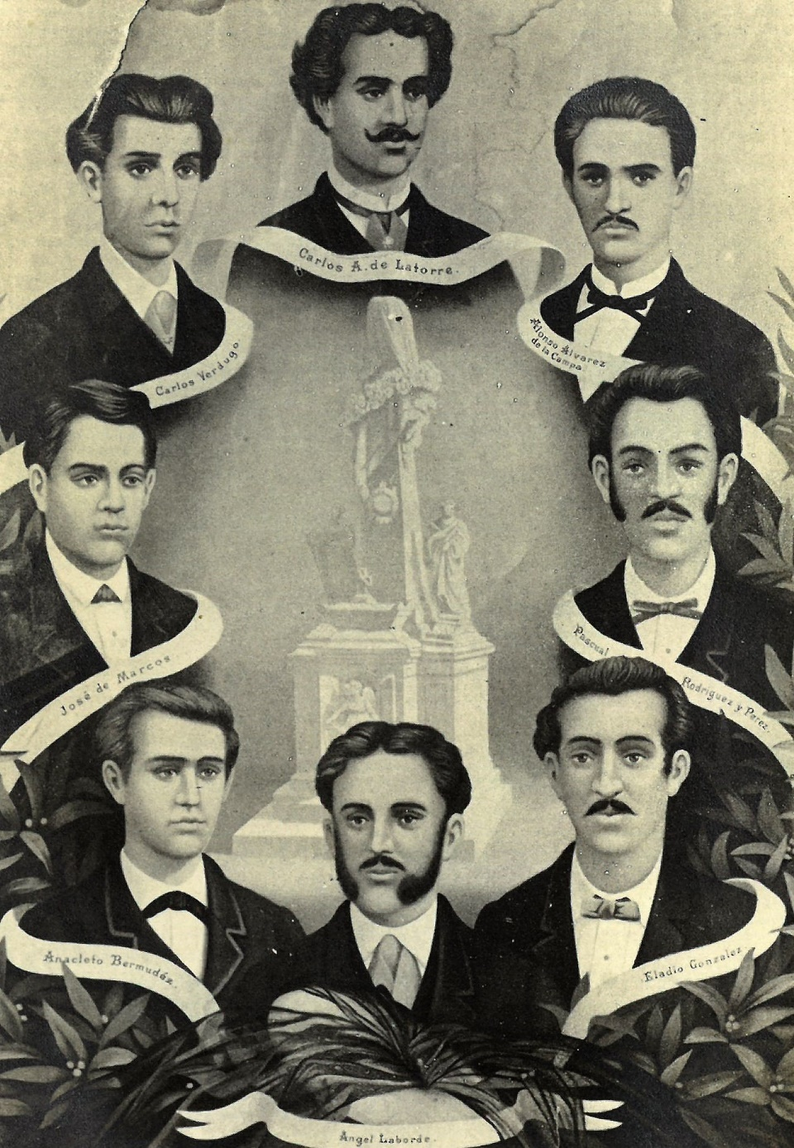
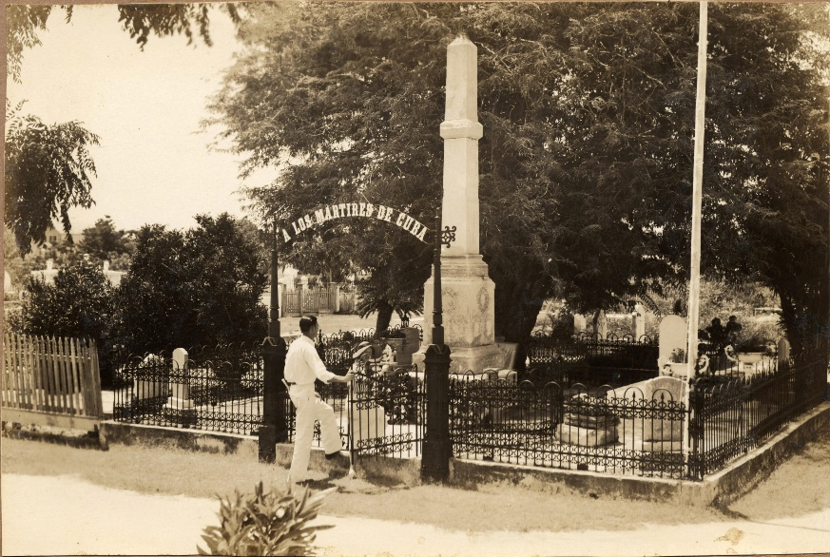
Patriotic Celebrations
Provided opportunities for community mobilizations: On 10 de Octubre and 27 de Noviembre, in particular, community attended speeches and parades. These celebrations instilled a deep patriotic commitment across generations.
A Los Mártires de Cuba, October 10, 1892, on the site of José Francisco Lamadriz’s grave.
Medical Students Executed For Anti-Spanish on November 27, 1871

Slide 19
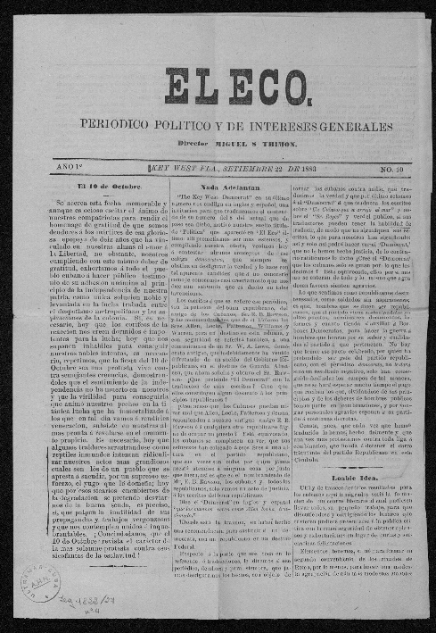
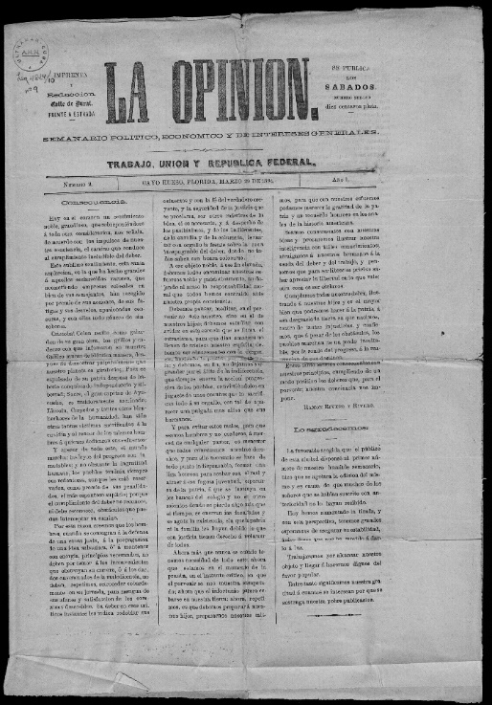
Cubans and US Politics: Exiles and Ethnics
Cubans voted for local politicians who supported their Cuban independence activism but they sometimes divided along party lines on other local economic and social issues.
Fernando Figueredo, member of Florida Assembly from Monroe County
Carlos Manuel de Céspedes y Céspedes, mayor of Key West
Cuban Republican Newspapers

Slide 20
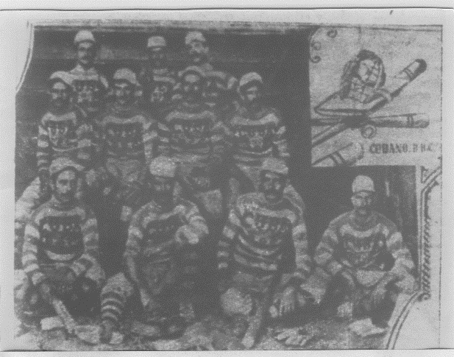
Baseball
USS Maine baseball team played against Cuban teams when anchored in Key West
Cubans adopted baseball in Key West and it quickly became their favorite pastime. A formal league with four teams began playing championships in 1888. Key West teams also competed with teams in Cuba and Tampa. Besides entertaining fans, baseball raised money for the revolutionary movements.
Cubano Baseball Club, Havana 1899. Earlier, many of these men played on Key West Baseball Clubs

Slide 21
Questions

Slide 22
3 Evolving Revolutionary Strategies: 1870s-1880s

Slide 23
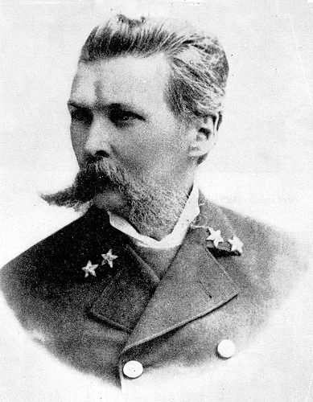
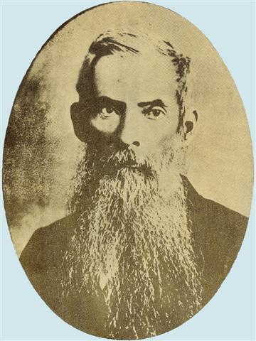
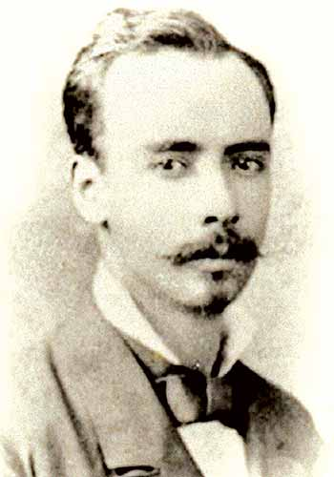
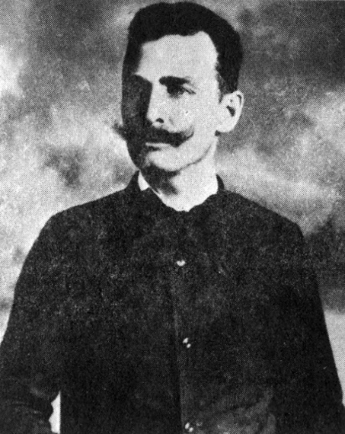
Independence War Visitors To Key West, 1870-1880: Establishing a Tradition
Cuban Insurrectionary officials and military leaders visited Key West regularly to raise funds for expeditions, establishing a tradition that endured through the 1890s.
Vice-President of the Cuban Republic Francisco Vicente Aguilera
General Manuel de Quesada
General Calixto García
Leoncio Prado, Son of Peruvian President Manuel Prado
General Julio Sanguily

Slide 24
Fundraising in the Community
During Ten Years War, visitors seeking funds met with local leaders. Together they established a tradition of going factory to factory making speeches and collecting money for expeditions. They also appeared at public gatherings at the various political clubs, especially San Carlos Institute.
Activists collected funds on a regular basis in the community, including providing receipts for bonds issued by revolutionary representatives in New York.

Slide 25
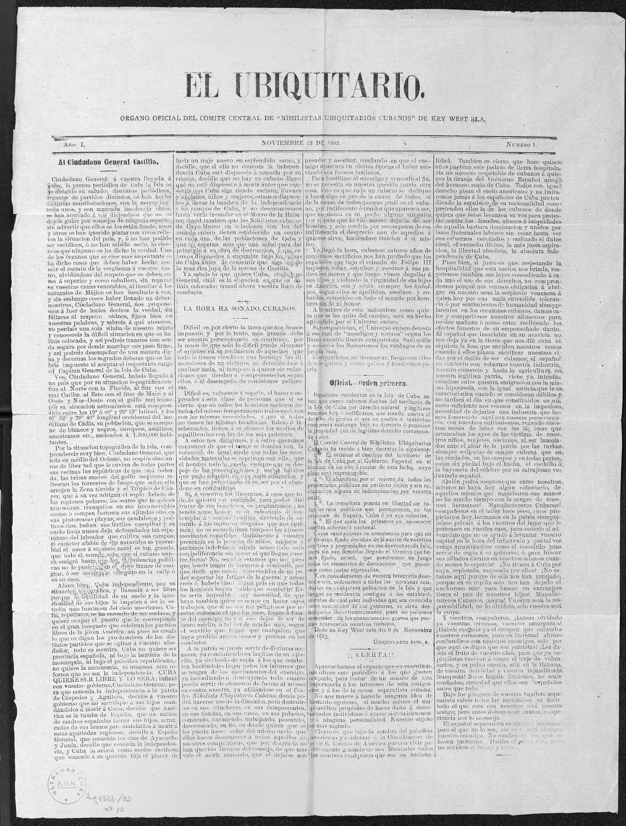
Pacification and Radicalization
Club Nihilista de Cayo Hueso-
After defeat of organized revolutionary forces in Cuba in 1880, exiles advocated “scientific warfare” or the use of dynamite and sabotage to demoralize Spanish state and population

Slide 26
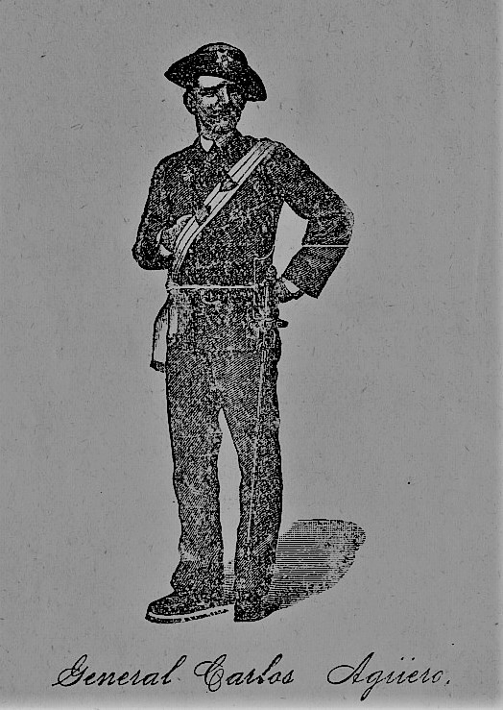
Guerrilla War
Remnants of Ten Years War military forces established guerrilla operations led by Carlos Aguero and Ramón Leocadio Bonachea in 1883-1884.
They sought moral and financial support in Key West and New York. New York exiles opposed these activities.
Ramón Leocadio Bonachea

Slide 27
Invasion
In 1885, Máximo Gómez and Antonio Maceo join the ongoing revolutionary activities in Key West and initiate efforts to form expeditions capable of launching a new independence was in Cuba. New York opposed the initiatives.
General Antonio Maceo
General Máximo Gómez

Slide 28
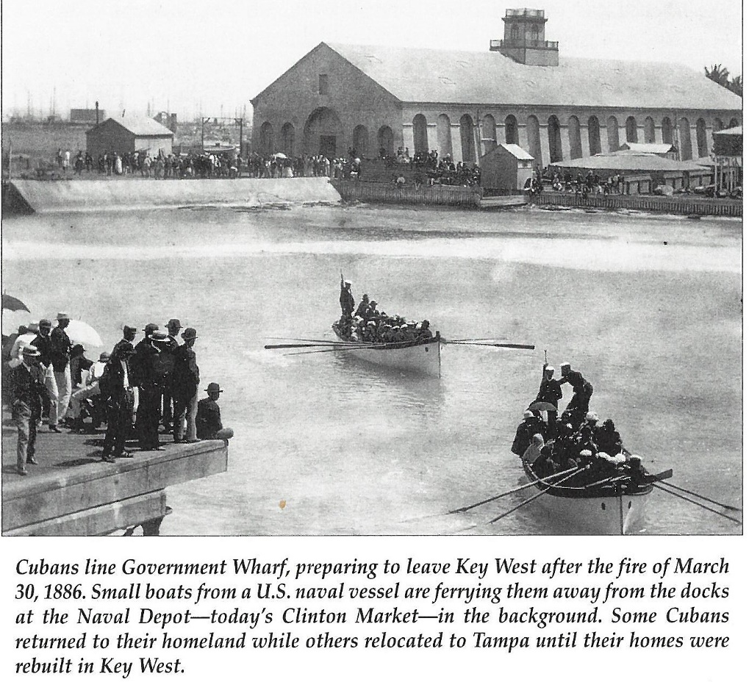
Key West Fire, 1886
Destroyed a quarter to a third of Key West, including many cigar factories, and threatened destruction of Cuban nationalism movement in the United States

Slide 29
Patriot Bandits
During the 1880s, bandits roamed the Cuban countryside kidnapping farmers and planters and ransomed them for significant sums of money. Spanish troops often forced them to abandon Cuba for Key West where many were politicized and returned to Cuba to continue their activities with a new purpose.
Known as the “Rey de los Campos,” bandit Manuel García worked directly with the Cuban revolutionary leadership in Key West.

Slide 30
Convención Cubana and Revolutionary Cells in Cuba (1889)
Secret organization dedicated to fund-raising, and establishing revolutionary clubs in Key West and Cuba.
Public Arm: Club Luz de Yara

Slide 31
Questions

Slide 32
4 Preserving the Revolutionary Community: Labor and Nationalism

Slide 33
Nationalist Labor
Labor Movement in Key West initially supported the independence movement during 1873-1884
Organized highly effective fund-raising system in factories
Used apprenticeship system to exclude Spanish workers unsympathetic to Cuban independence

Slide 34
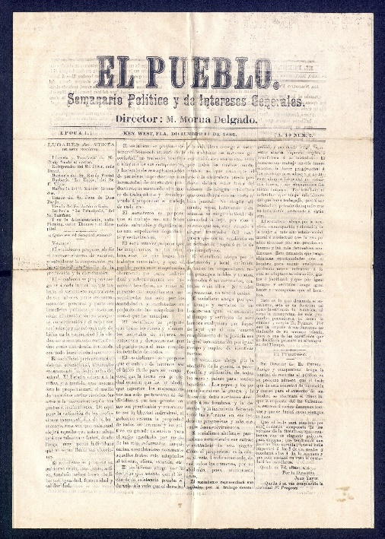
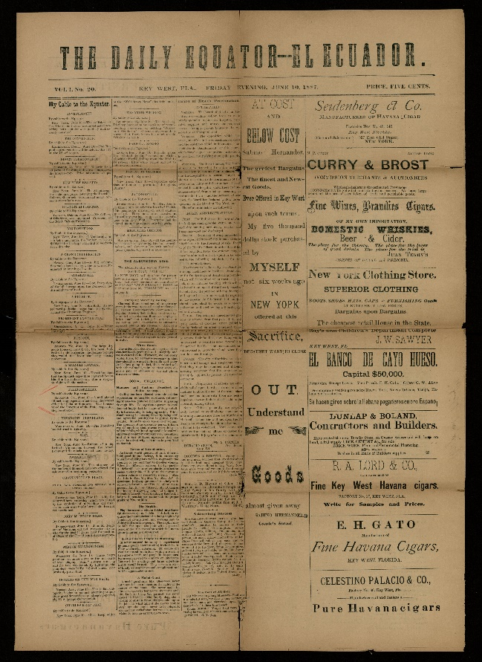
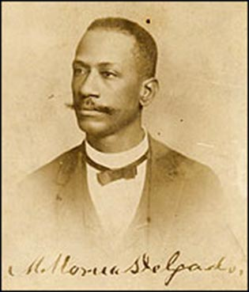
Knights of Labor: Called for labor and class unity regardless of ethnic differences. Advocated labor solidarity over nationalist solidarity in the factories. Cubans and Spaniards formed Assemblies and supported each other.
Ramón Rivero and Charles Pendleton, editors
Martín Morúa Delgado, editor
Daily Equator—El Ecuador

Slide 35
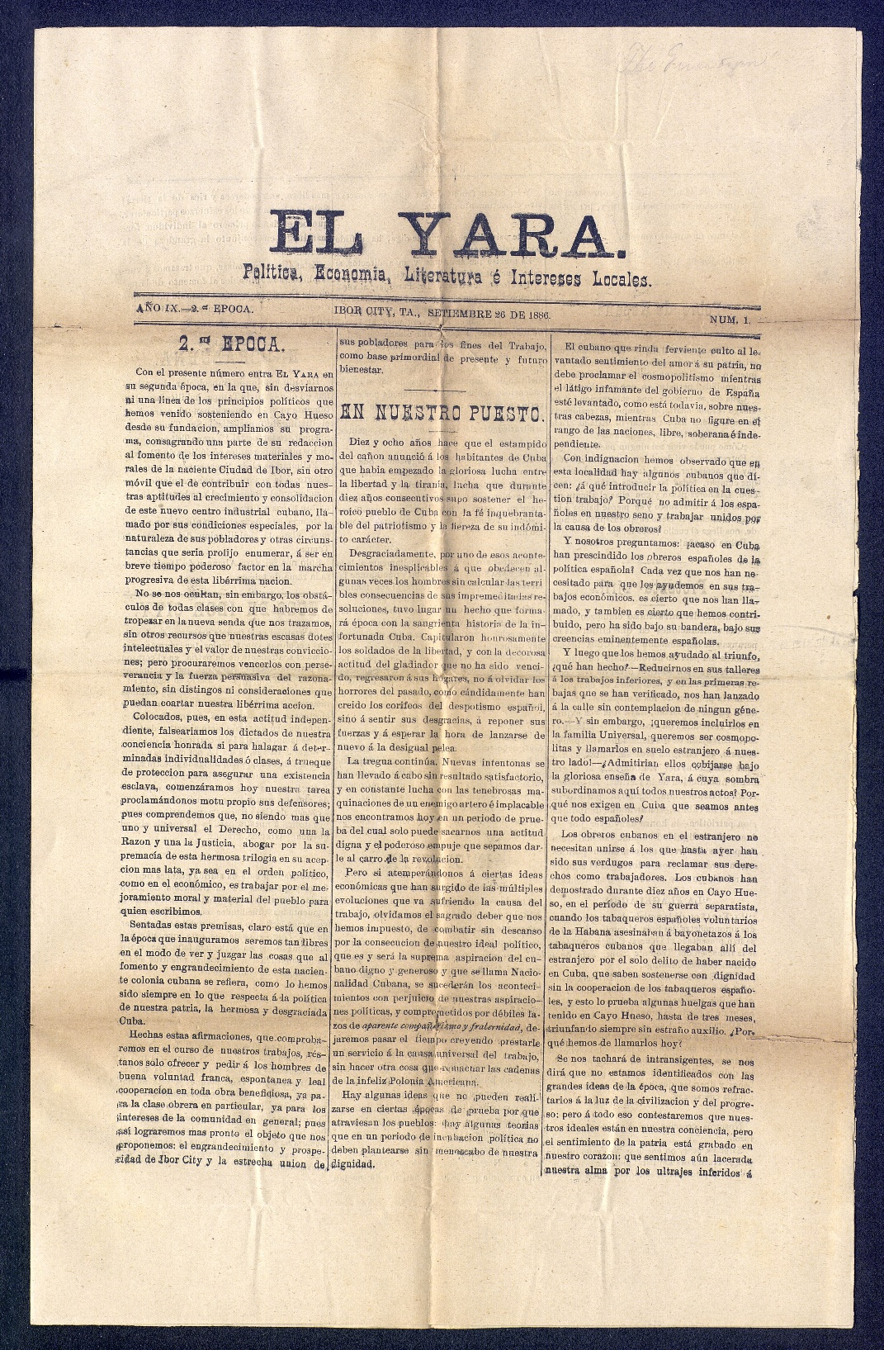
Tampa-Ybor City
A New Revolutionary Center- 1886/1887
After the Key West fire, El Yara moved to Tampa and advocated nationalist over labor solidarity. Manufactures and Knights of Labor defeated the nationalists

Slide 36
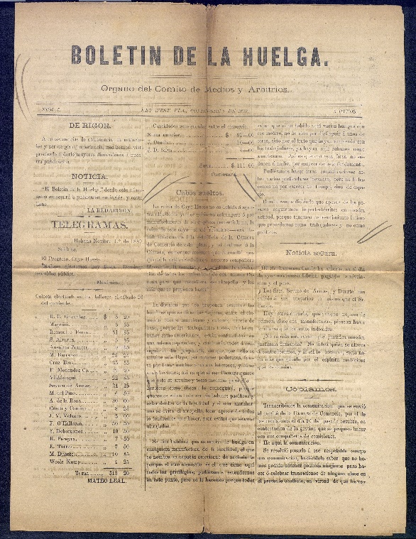
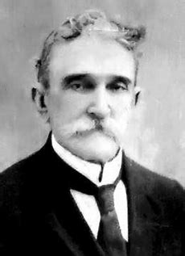
Anarchists
Anarchists opposed nationalism in principle. Advocated class based revolutionary socialism and opposed revolutionary nationalism. Fight in the factories not on Cuban battlefields.
Cuban anarchists ultimately returned to the nationalist fold beginning in 1890
Newspapers published by the strike committee during strike of 1889
Carlos Baliño, editor of La Tribuna del Trabajo
Other anarchist leaders.
*Enrique Creci, editor of El Buñuelo
*Federico Corbet, editor La Justicia

Slide 37
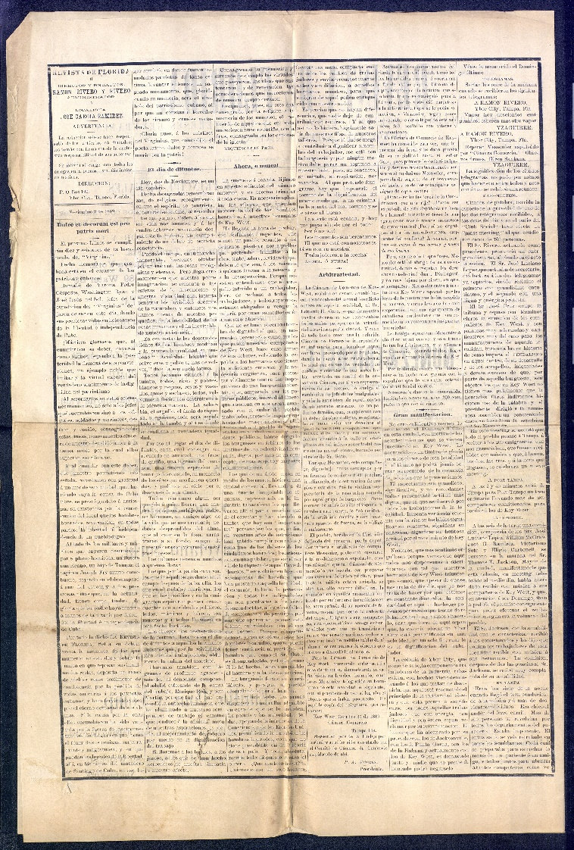
Many Labor Leaders Moved to Tampa, 1889
In 1889, Ramón Rivero, Enrique Creci, Francisco Segura, and others founded Revista de Florida in Tampa to support labor causes

Slide 38
Questions

Slide 39
5 José Martí and Key West: Rethinking the Relationship

Slide 40
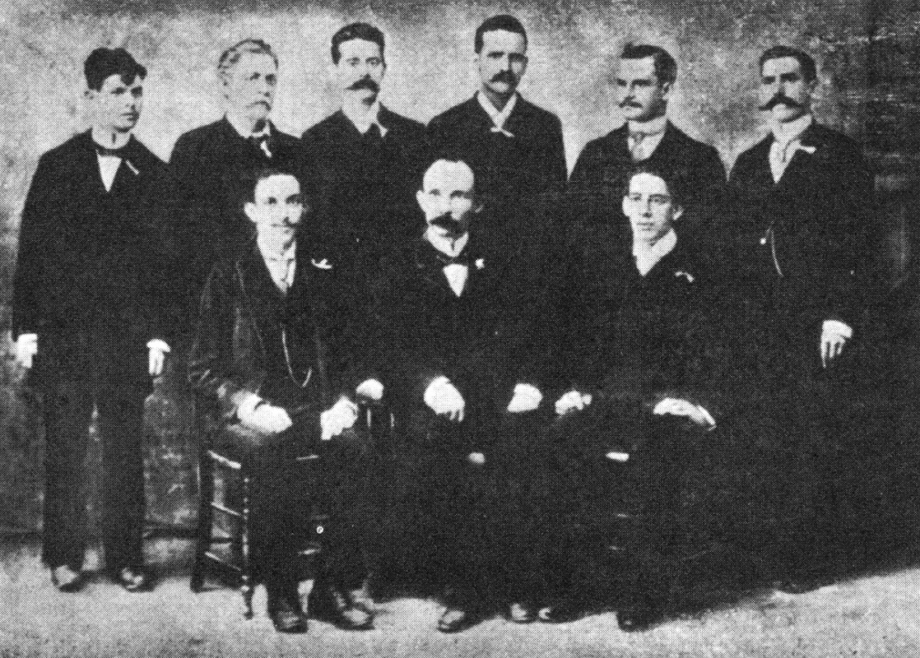
Key West’s Invitation to Martí
With the backing of the Convención Cubana, a group of cigar workers invited Martí to Key West in late 1891.
Martí and the Invitation Committee

Slide 41
Martí in the Factories
Marti entered highly organized factories where workers heard him speak of La Patria with passion and unifying language.
Martí in a Factory with Poyo, Figueredo, and Martín Herrera

Slide 42
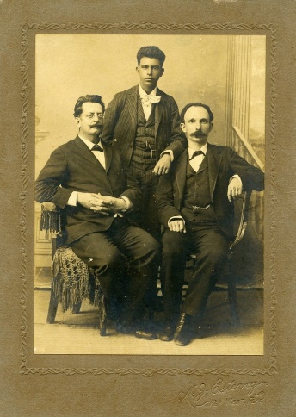
Martí and the Community
Fermín Valdéz Dominguez,
Panchito Gómez,
and Martí
Martí’s personal charisma and way with words was always on display and attracted many to the cause of Cuban nationalism

Slide 43
Partido Revolucionario Cubano Final PRC charter written and approved in Key West, January 1892. * Democratic representation * Highly centralized organization designed for immediate revolutionary action.

Slide 44
The Pelaez and Figueredo Debate
Martí provided new enthusiasm that mobilized workers in support of nationalism after almost a decade of pro-labor activism
Martí articulated a political program and organizational structure that combined his ideas with those of the Key West leadership
Key West insisted on revolutionary action in the short-term which Martí accepted.
Key West’s established connections with revolutionary cells in Cuba provided the framework for Martí’s continued work organizing the island.
Key West’s established fund raising mechanism and established nationalist cigar manufacturers was Martí’s most reliable source of funds.
Angel Pelaez: Conventional interpretation- Martí single-handedly inspired Key West’s revolutionary activism
Fernando Figueredo: Key West was a long established revolutonary center that provided Martí with the tools and resources for organizing a new revolutionary effort

Slide 45
Questions

Slide 46
6 Cuban Nationalism and US Imperialism

Slide 47
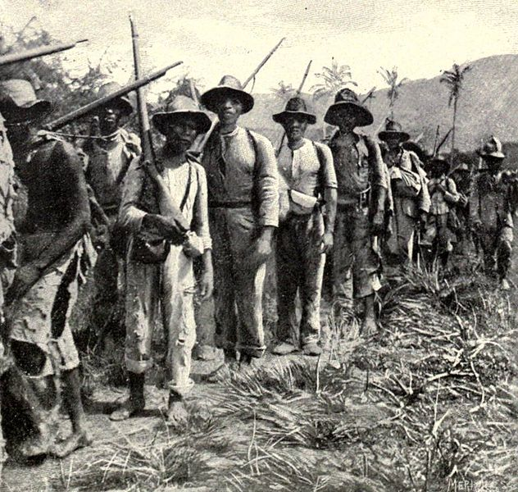
Expeditions
After start of independence war in the Cuban west, Key West launched the first the major expedition from the United States commanded by Carlos Roloff and Serafín Sánchez. Landed on the southern coast of Las Villas, launching the war in the center of the island.
Subsequent expeditions left mostly from spots on the coast Atlantic coast less subject to surveillance by the US Coast Guard.
Key West provided financial resources but US obstruction blocked any chances of a Cuban victory over the Spanish and at the same time justified US intervention.

Slide 48
Politics & Ideology
Despite commitments to unity of action, the exile leadership representated varying perspectives, from José D. Poyo’s radical nationalism to Tomás Estrada Palma’s annexationist instincts.
Much to Poyo’s dismay and Estrada Palma’s satisfaction the war ended with US occupation of Cuba. Poyo never challenged Estrada’s policies as PRC Delegado citing the need for revolutionary unity above all else.
José D. Poyo (Head of the PRC in Key West), Tomás Estrada Palma (PRC Delegado, NY), and José A. González Lanuza (PRC Secretary, NY)

Slide 49
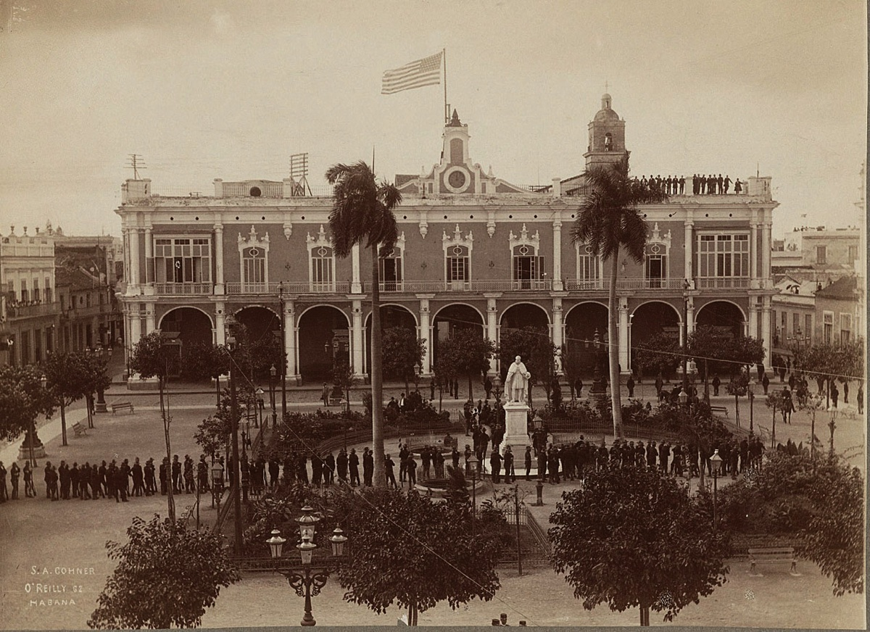
US Occupation and The Plattist Republic
US Takes Possession of Cuba from the Spain, January 1899

Slide 50
Questions

