Slide 1
Unpacking “National Prominence”
Open Forum 3
A Starting Point…

Slide 2
Strategic Priority Open Forums
Thursday, September 18 from 2:30-3:30*
Friday, October 17 from 10:30-11:30*
Wednesday, November 12 from 9:30-10:30*

Slide 3
Where do we start?
Sian Beilock, president, Dartmouth University
“…the idea of iteration and sort of putting your mental model out there and letting people push back on it and then iterating from there.”

Slide 4
President’s Three Overarching Pillars
Impact on People and Communities
Academic and Reputational Excellence
Endowment and Institutional Sustainability

Slide 5
Today
Consider the division’s strategic priorities
“Four Cornerstone” strategic model
Academic and reputational excellence

Slide 6
UTampa Mission Statement
The University of Tampa is a comprehensive, independent university that delivers challenging and high-quality educational experiences to a diverse group of learners. Four colleges offer about 200 areas of graduate and undergraduate study. The Spartan Studies general education curriculum helps to prepare students to be successful, contributing members of the global community. Graduate and continuing studies programs exemplify our commitment to the professions and community.
The University’s 110-acre residential campus in downtown Tampa provides an exceptional setting for learning both on and off campus. Valuing the community’s international heritage, the University attracts students, faculty and staff from around the world with diverse backgrounds to facilitate intercultural learning.
UT is committed to the development of each student to become a productive and responsible citizen. The University conducts classes in personalized settings in which learning is enhanced through application by balancing “learning by thinking” with “learning by doing.” Students are taught by highly qualified faculty members dedicated to teaching, scholarship, advising and continued intellectual growth. Students participate in learning partnerships with faculty and the community through clinical and consulting assignments, internships and research experiences. Academic services and co-curricular activities support individual well-being and development, and provide leadership opportunities. UT strives to provide a rich and inclusive learning environment for all students to prepare them for careers and lifelong learning.

Slide 7
Open Forum 1: Who are we and what inspires us?
Student-centered culture and success.
Personalized learning environment.
Relationship-based education.
Experiential learning (UG research, FYS, internships).
Career readiness mindset.
Identity and place.

Slide 8
Open Forum 1: What aspects of our institutional culture should we preserve as we grow?
The “small school” relational culture.
Student-centered partnerships.
Community collaboration.
Empathy & kindness.
Academic freedom and educational excellence.

Slide 9
Assumptions of Strategic Priorities
The four cornerstones ladder up to the three presidential priorities
Ideally, college plans would ladder up to both
Annual reporting follows the cornerstones
Resources follow the cornerstones
KPIs demonstrate progress for each cornerstone
Revisit and recalibrate annually

Slide 10
A Proposal

Slide 11
Strategic Priorities Framework (proposal)
A Four Cornerstone Strategic Framework:
National prominence
Community engagement
Technology and digital transformation
Student success

Slide 12
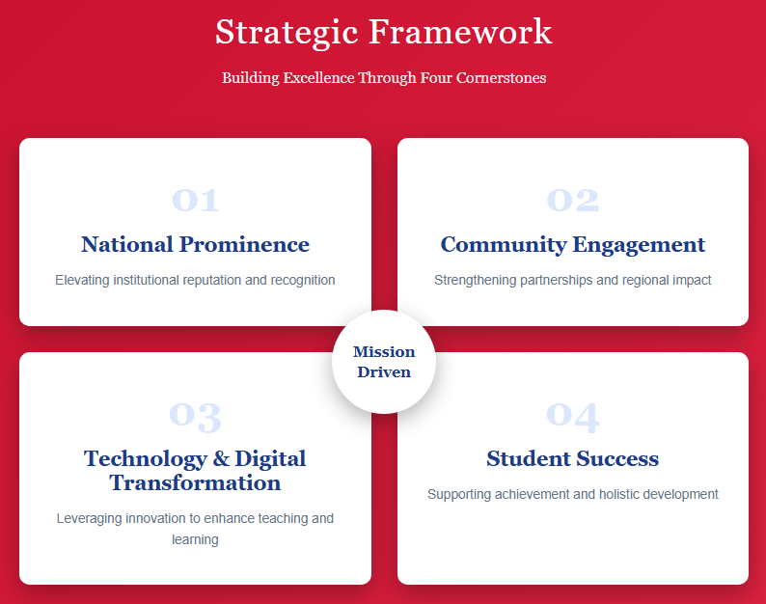

Slide 13
Four Cornerstones
Cornerstone #1
National Prominence
Elevate public scholarship (research & scholarship)
Research College and University designation (Carnegie)
Expand OSP (to ORSP)
Cultivate faculty success
Nominate faculty for regional and national awards
Mentoring and faculty development
Revisit internal grant funding
Create new graduate programs
Master’s level professional programs
Doctoral level academic programs

Slide 14
Unpacking Public Scholarship
Elevate public scholarship (research & scholarship)
Research College and University designation (Carnegie)
Expand OSP (to ORSP)

Slide 15
2025 Carnegie Research Classifications
X
Research 1: Very High Spending and Doctorate Production
At least $50 million on R&D
Award at least 70 research doctorates
Research 2: High Spending and Doctorate Production
At least $5 million on R&D
Award at least 20 research doctorates
Research College and University (RCU)
At least $2.5 million on R&D

Slide 16
Ok, so are we close?

Slide 17
NSF HERD Survey of R&D Expenditures

Slide 18
NSF HERD Survey of R&D Expenditures

Slide 20
FAQ: If we pursue an RCU…
Q1: Do teaching loads change?
A1: No. But grant funding may be used to buy out teaching a class.
Q2: For T/TT faculty, will there be a “research track” and a “teaching track”?
A2: No.
Q3: Are faculty expected to get grants?
A3: No. Even R1s and R2s don’t have uniform expectations for all academic units.

Slide 21
FAQ: If we pursue a RCU…
Q4: Do tenure and promotion criteria change for research?
A4: Not necessarily. Departments should identify T&P criteria unique to their units.
Q5: What does change?
A5: Existing resources for individual grants may change. The biggest change, however, is that the Provost may request resources for new interdisciplinary seed grants to position groups of faculty to succeed with federal grants.
Example: at my previous institution, a $500,000 investment of one-time funds turned into $3.2M in external grant submissions and $1.8M in federal awards.

Slide 22
Other RCUs
University of St. Thomas* (MN)
Elon University* (NC)
Sacred Heart* (CT)
Davidson (NC)
Amherst (MA)
Trinity Univ (TX)
Colorado College (CO)

Slide 23
Thoughts, Comments, Questions

Slide 24
Four Cornerstones
Cornerstone #1
National Prominence
Elevate public scholarship (research & scholarship)
Research College and University designation (Carnegie)
Expand OSP (to ORSP)
Cultivate faculty success
Nominate faculty for regional and national awards
Mentoring and faculty development
Revisit internal grant funding
Create new graduate programs
Master’s level professional programs
Doctoral level academic programs

Slide 25
Unpacking Faculty Success
Cultivate faculty success
Nominate faculty for regional and national awards
Also addresses national prominence
Mentoring and faculty development
At different levels and across disciplines
Revisit internal grant funding
When were amounts last increased? Evaluated?

Slide 26
Unpacking Faculty Success
Provide support for T&P, sabbaticals
Search committee training
Best practices in recruiting and retention
Uniform and consistent mentoring
Faculty expert list, promote to media outlets

Slide 27
Thoughts, Comments, Questions

Slide 28
Four Cornerstones
Cornerstone #1
National Prominence
Elevate public scholarship (research & scholarship)
Research College and University designation (Carnegie)
Expand OSP (to ORSP)
Cultivate faculty success
Nominate faculty for regional and national awards
Mentoring and faculty development
Revisit internal grant funding
Create new graduate programs
Master’s level professional programs
Doctoral level academic programs

Slide 29
Total Grad Enrollment

Slide 31
Unpacking Graduate Education
“The process of establishing a new academic degree major, minor, or certificate begins with the establishment of a feasibility committee consisting of the sponsoring department’s faculty and the dean. The committee’s product is a feasibility report, which provides an analysis of: alignment with the university’s mission; student demand; faculty credentials and need; resources, including facilities and Information Technology, library materials, or equipment needs; and a pro forma budget reflecting revenue and costs.”
Faculty Handbook p. 15

Slide 33
From Forum 1: What specific ideas do you have so that UTampa remains relevant, agile, and innovative?
Strategic growth and program development. (Cornerstone 1)
Faculty support and competitiveness. (Cornerstone 1)
Research infrastructure and investment. (Cornerstone 1)
Physical and technological resources. (Cornerstone 3)
Cross-campus collaboration and innovation. (Cornerstone 4)
Student access and success. (Cornerstones 2, 4)
High-touch commitment. (Cornerstones 2, 4)
Agility through resources. (Cornerstones 1-4)

