Slide 1
Strategic Priorities for Academic Affairs
Open Forum 2
A Starting Point…

Slide 2
Strategic Priority Open Forums
Thursday, September 18 from 2:30-3:30*
Friday, October 17 from 10:30-11:30*
Wednesday, November 12 from 9:30-10:30

Slide 3
President’s Three Overarching Pillars
Impact on People and Communities
Academic and Reputational Excellence
Endowment and Institutional Sustainability

Slide 4
Where do we start?
Sian Beilock, president, Dartmouth University
“…the idea of iteration and sort of putting your mental model out there and letting people push back on it and then iterating from there.”

Slide 5
Today
Consider the division’s strategic priorities
  Present a “Four Cornerstone” strategic model
  At tables, discuss pros, cons, & other factors for each cornerstone
  Report out to large group key points from table discussions
Academic and reputational excellence

Slide 6
Structured table discussions
On your notepad:
  CORNERSTONE #1 (2, 3, 4)
  Pros
  Cons
  Other

Slide 7
Context is important.

Slide 8
President’s Three Overarching Pillars
Impact on People and Communities
Academic and Reputational Excellence
Endowment and Institutional Sustainability

Slide 9
UTampa Mission Statement
The University of Tampa is a comprehensive, independent university that delivers challenging and high-quality educational experiences to a diverse group of learners. Four colleges offer about 200 areas of graduate and undergraduate study. The Spartan Studies general education curriculum helps to prepare students to be successful, contributing members of the global community. Graduate and continuing studies programs exemplify our commitment to the professions and community.
The University’s 110-acre residential campus in downtown Tampa provides an exceptional setting for learning both on and off campus. Valuing the community’s international heritage, the University attracts students, faculty and staff from around the world with diverse backgrounds to facilitate intercultural learning.
UT is committed to the development of each student to become a productive and responsible citizen. The University conducts classes in personalized settings in which learning is enhanced through application by balancing “learning by thinking” with “learning by doing.” Students are taught by highly qualified faculty members dedicated to teaching, scholarship, advising and continued intellectual growth. Students participate in learning partnerships with faculty and the community through clinical and consulting assignments, internships and research experiences. Academic services and co-curricular activities support individual well-being and development, and provide leadership opportunities. UT strives to provide a rich and inclusive learning environment for all students to prepare them for careers and lifelong learning.

Slide 10
Open Forum 1:
Who are we and what inspires us?
Student-centered culture and success.
Personalized learning environment.
Relationship-based education.
Experiential learning (UG research, FYS, internships).
Career readiness mindset.
Identity and place.

Slide 11
Open Forum 1:
What aspects of our institutional culture should we preserve as we grow?
The “small school” relational culture.
Student-centered partnerships.
Community collaboration.
Empathy & kindness.
Academic freedom and educational excellence.
Identity and place.

Slide 12
Some of what I’ve heard to date…
Research & scholarship (Carnegie designation Research College & University)
Community Engaged Campus (Carnegie designation)
Faculty success
Leadership with a Public Purpose (Carnegie designation)
Microcredentials
Regional partnerships
Technology integration
Graduate and professional programs
Interdisciplinary research and academic programs
Office for cultivating students and faculty for national awards
Phi Beta Kappa
Professional staff advising model

Slide 13
Assumptions of Strategic Priorities
The four cornerstones ladder up to the three presidential priorities
  Ideally, college plans would ladder up to both
Annual reporting follows the cornerstones
Resources follow the cornerstones
KPIs demonstrate progress for each cornerstone
Revisit and recalibrate annually

Slide 14
A Proposal

Slide 15
Strategic Priorities Framework (proposal)
A Four Cornerstone Strategic Framework:
National prominence
Community engagement
Technology and digital transformation
Student success

Slide 16
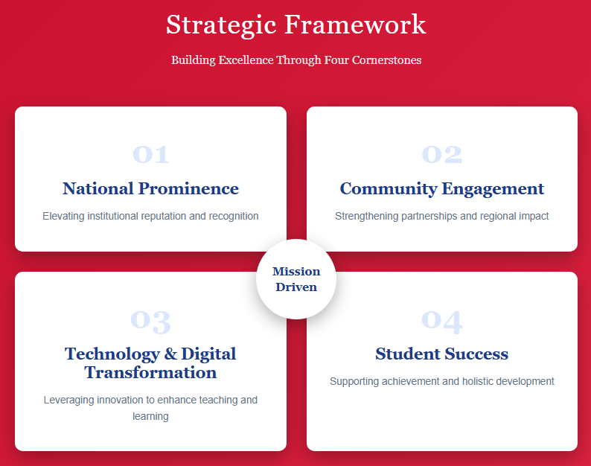

Slide 17
Four Cornerstones
Cornerstone #1
National Prominence
  Elevate public scholarship (research & scholarship)
    Research College and University designation (Carnegie)
    Expand OSP (to ORSP)
  Cultivate faculty success
    Revisit internal grant funding
    Nominate faculty for regional and national awards
    Mentoring and faculty development
  Create new graduate programs
    Master’s level professional programs
    Doctoral level academic programs

Slide 18
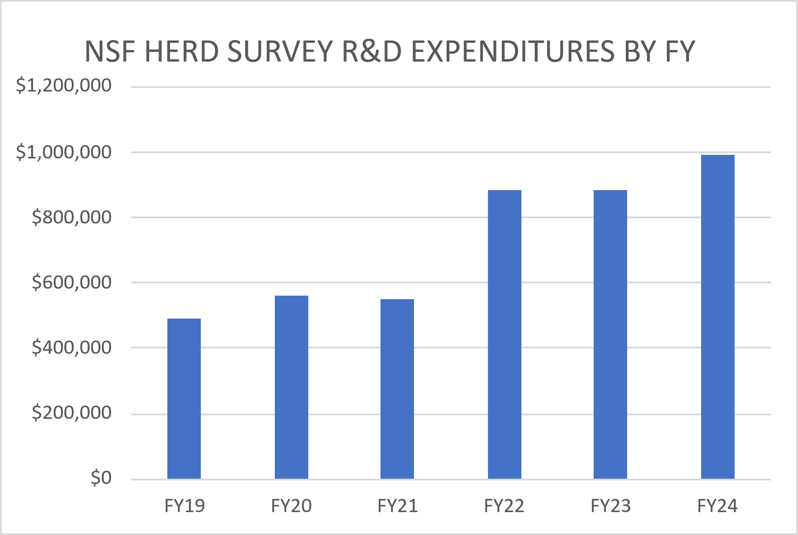
NSF HERD Survey of R&D Expenditures

Slide 19
2025 Carnegie Research Classifications
Research 1: Very High Spending and Doctorate Production
  At least $50 million on R&D
  Award at least 70 research doctorates
Research 2: High Spending and Doctorate Production
  At least $5 million on R&D
  Award at least 20 research doctorates
Research College and University
  At least $2.5 million on R&D

Slide 20
Four Cornerstones
Cornerstone #1
National Prominence
  Elevate public scholarship (research & scholarship)
    Research College and University designation (Carnegie)
    Expand OSP (to ORSP)
  Cultivate faculty success
    Revisit internal grant funding
    Nominate faculty for regional and national awards
    Mentoring and faculty development
  Create new graduate programs
    Master’s level professional programs
    Doctoral level academic programs

Slide 22
Four Cornerstones
Cornerstone #2
Community Engagement
  Regional partnerships
  Internships for all
  Academic community engagement
    Carnegie designation as a Community Engaged campus

Slide 24
Four Cornerstones
Cornerstone #3
Technology and Digital Transformation
  AI/Digital literacy for faculty, staff, and students
  Active learning classrooms
  LMS centric (accessibility, student success)
  Use technology for student support

Slide 26
Four Cornerstone
Cornerstone #4
Student Success
  Scale up high impact practices (UG research, study abroad, internships)
  Expand wrap-around services
  Review advising model
  Review class scheduling [space issue]
  Microcredentials
  Interdisciplinary opportunities

Slide 28
From Forum 1: What specific ideas do you have so that UTampa remains relevant, agile, and innovative?
Strategic growth and program development. (Cornerstone 1)
Faculty support and competitiveness. (Cornerstone 1)
Research infrastructure and investment. (Cornerstone 1)
Physical and technological resources. (Cornerstone 3)
Cross-campus collaboration and innovation. (Cornerstone 4)
Student access and success. (Cornerstones 2, 4)
High-touch commitment. (Cornerstones 2, 4)
Agility through resources. (Cornerstones 1-4)

Slide 29
Strategic Priority Open Forums
Next Open Forum
Wednesday, November 12 from 9:30-10:30

